Slide 1
A rapid response is called on a patient who is 12-hours post-op from a laminectomy. They appear unresponsive, with pinpoint pupils, and significant respiratory depression. Otherwise, vital signs are normal. Despite repeated doses of naloxone, the patient does not respond. What is the next appropriate step?
Continue administering naloxone until the patient responds
Advocate for moving the patient to the ICU
Defer management to the primary team

Slide 2
A rapid response is called on a patient who is 12-hours post-op from a laminectomy. They appear unresponsive, with pinpoint pupils, and significant respiratory depression. Otherwise, vital signs are normal. Despite repeated doses of naloxone, the patient does not respond. What is the next appropriate step?
Continue administering naloxone until the patient responds
Advocate for moving the patient to the ICU
Defer management to the primary team

Slide 3
Rapid Response: Big Picture
Trajectory – will this turn into a code?
Disposition? Do they need to be in the ICU?
Considerations: instability, too frequent nursing care, initiation of titratable drip
Don’t delay – its often faster (and safer) to get things done in an ICU
If staying on the floor, stabilize and attempt work up promptly
Always hand off to the primary team assuming care

Slide 4

Family Presence During a Resuscitation (FRDR)
Setting family expectations
Solicit surrogate decision maker input (if appropriate)
This may be daunting to you in the moment
Family members (and physicians/nurses) appreciate FPDR
+ no change resuscitation characteristics or patient survival
Update family if not currently present
doi.org/10.1056/nejmoa1203366
Palliative Care Fast Facts #233
Notes:
Fascinators can identifying if family members are present and informing them about the ongoing resuscitation, if not already at the bedside
(2) assessing whether FPDR is appropriate based on the family’s emotional state and the resuscitation team being agreeable to FPDR, (3) limiting the number of visitors, (4) preparing the family about what to expect and where to position themselves in the room, and (5) update the family about the specific resuscitation efforts taking place and provide emotional support. Importantly, the facilitator may solicit the surrogate decision maker’s input on whether to continue resuscitation efforts.

Slide 5
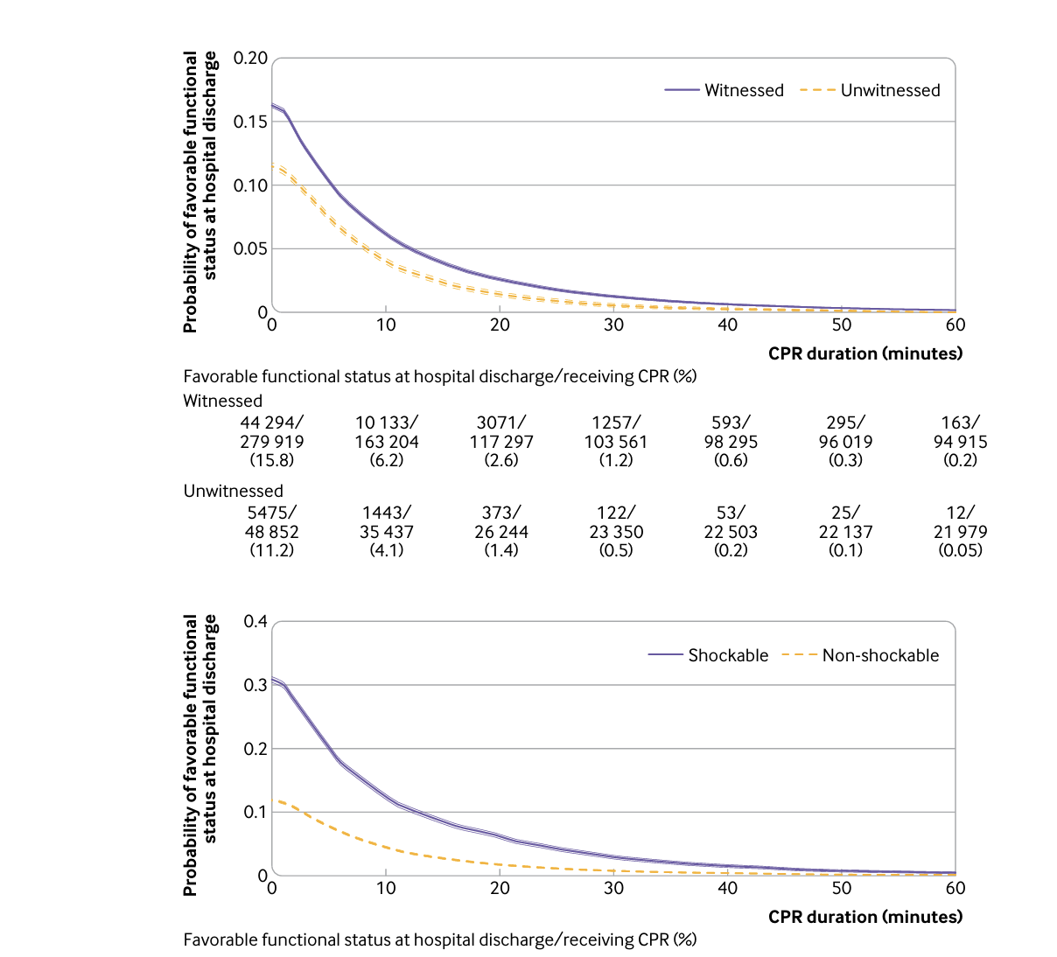
How long is too long?
BMJ. 2024 Feb 7:384:e076019. doi: 10.1136/bmj-2023-076019.
Things to consider:
Pre-arrest state (severity of illness)?
More ill = shorter
Is the (likely) cause reversible?
Less reversible = shorter
Shockable = Good! Asystole = Bad! PEA = … nuanced.
Notes:
The probabilities decreased over time and were <1% for survival at 39 minutes and <1% for favorable functional outcome at 32 minutes' duration of cardiopulmonary resuscitation.
PEA: initial rhythm 60% of the time, but precedes ROSC 75% of the time.
Half of patients with VF/VT pass through PEA on the way to ROSC
Transition from Asystole to PEA is a good sign.
If you achieve ROSC once, the likelihood of ROSC is higher

Slide 6

What else have we not thought of?
Illicit input from the team/family (but use your judgement as leader)
”Let’s stop CPR.”
Thank team members
Set time/location to debrief with team
debrief family (if present) separately

